Slide 1
TIS Solutions Appraisal Systems

Slide 2
--Meaning--
Appraisal is a process of evaluating an employee’s Performance of a job in terms of its requirements.

Slide 3
DESCRIPTION:
TIS Solutions has great work with their employees, with this in TIS Solutions they have increasing number of employees.
The motivational and performance level of their employees high. So, they want to implement this Appraisal System.
In the EMPLOYEE APPRAISAL APP all employees can know their performance with employee appraisal app.
This performance can be given in yearly, half-yearly, or quarterly to their employees.
This will help the employees to grow up and enhance skills with appraisal feedback and compliments for accomplishments.
By knowing all their performances employees will know all their accomplishments and they can perform better next time.

Slide 4
FLOW CHART of TIS_Solutions
TIS_Solutions
Reviews&
Rating
IT
HR
ACCOUNTS
10
employees
10
employees
10
employees

Slide 5
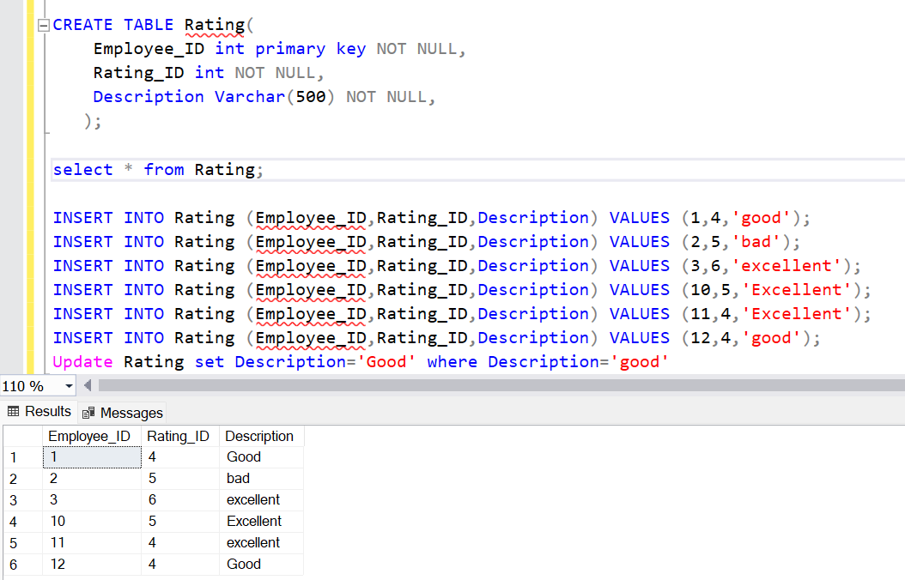
Creating AND Inserting DATA into Rating TABLE

Slide 6
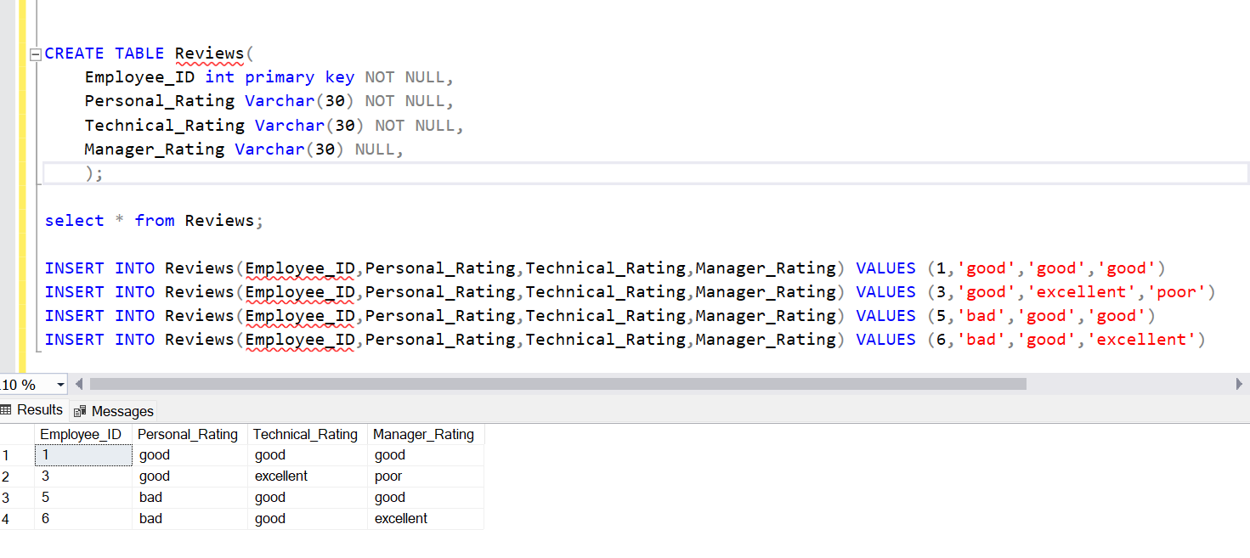
Creating AND Inserting DATA into Reviews TABLE

Slide 7
THANK YOU

